Slide 1
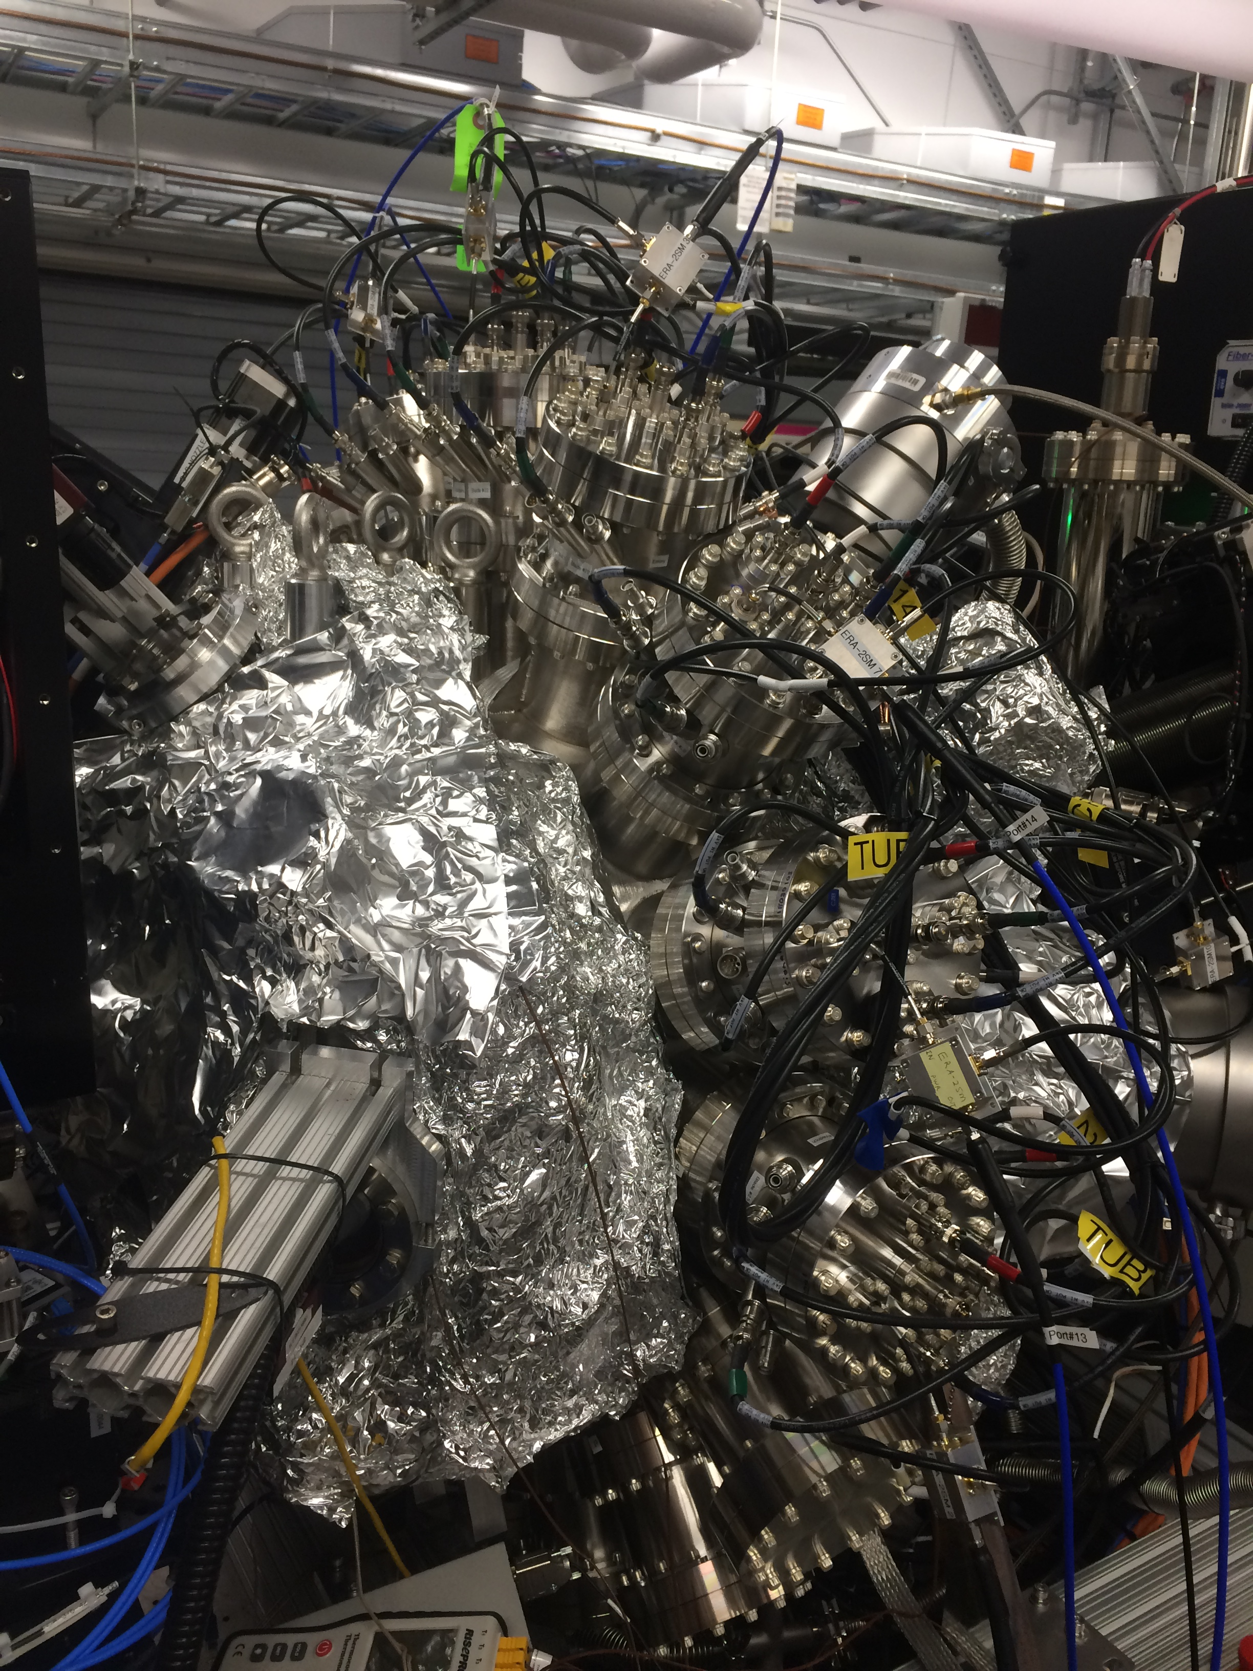
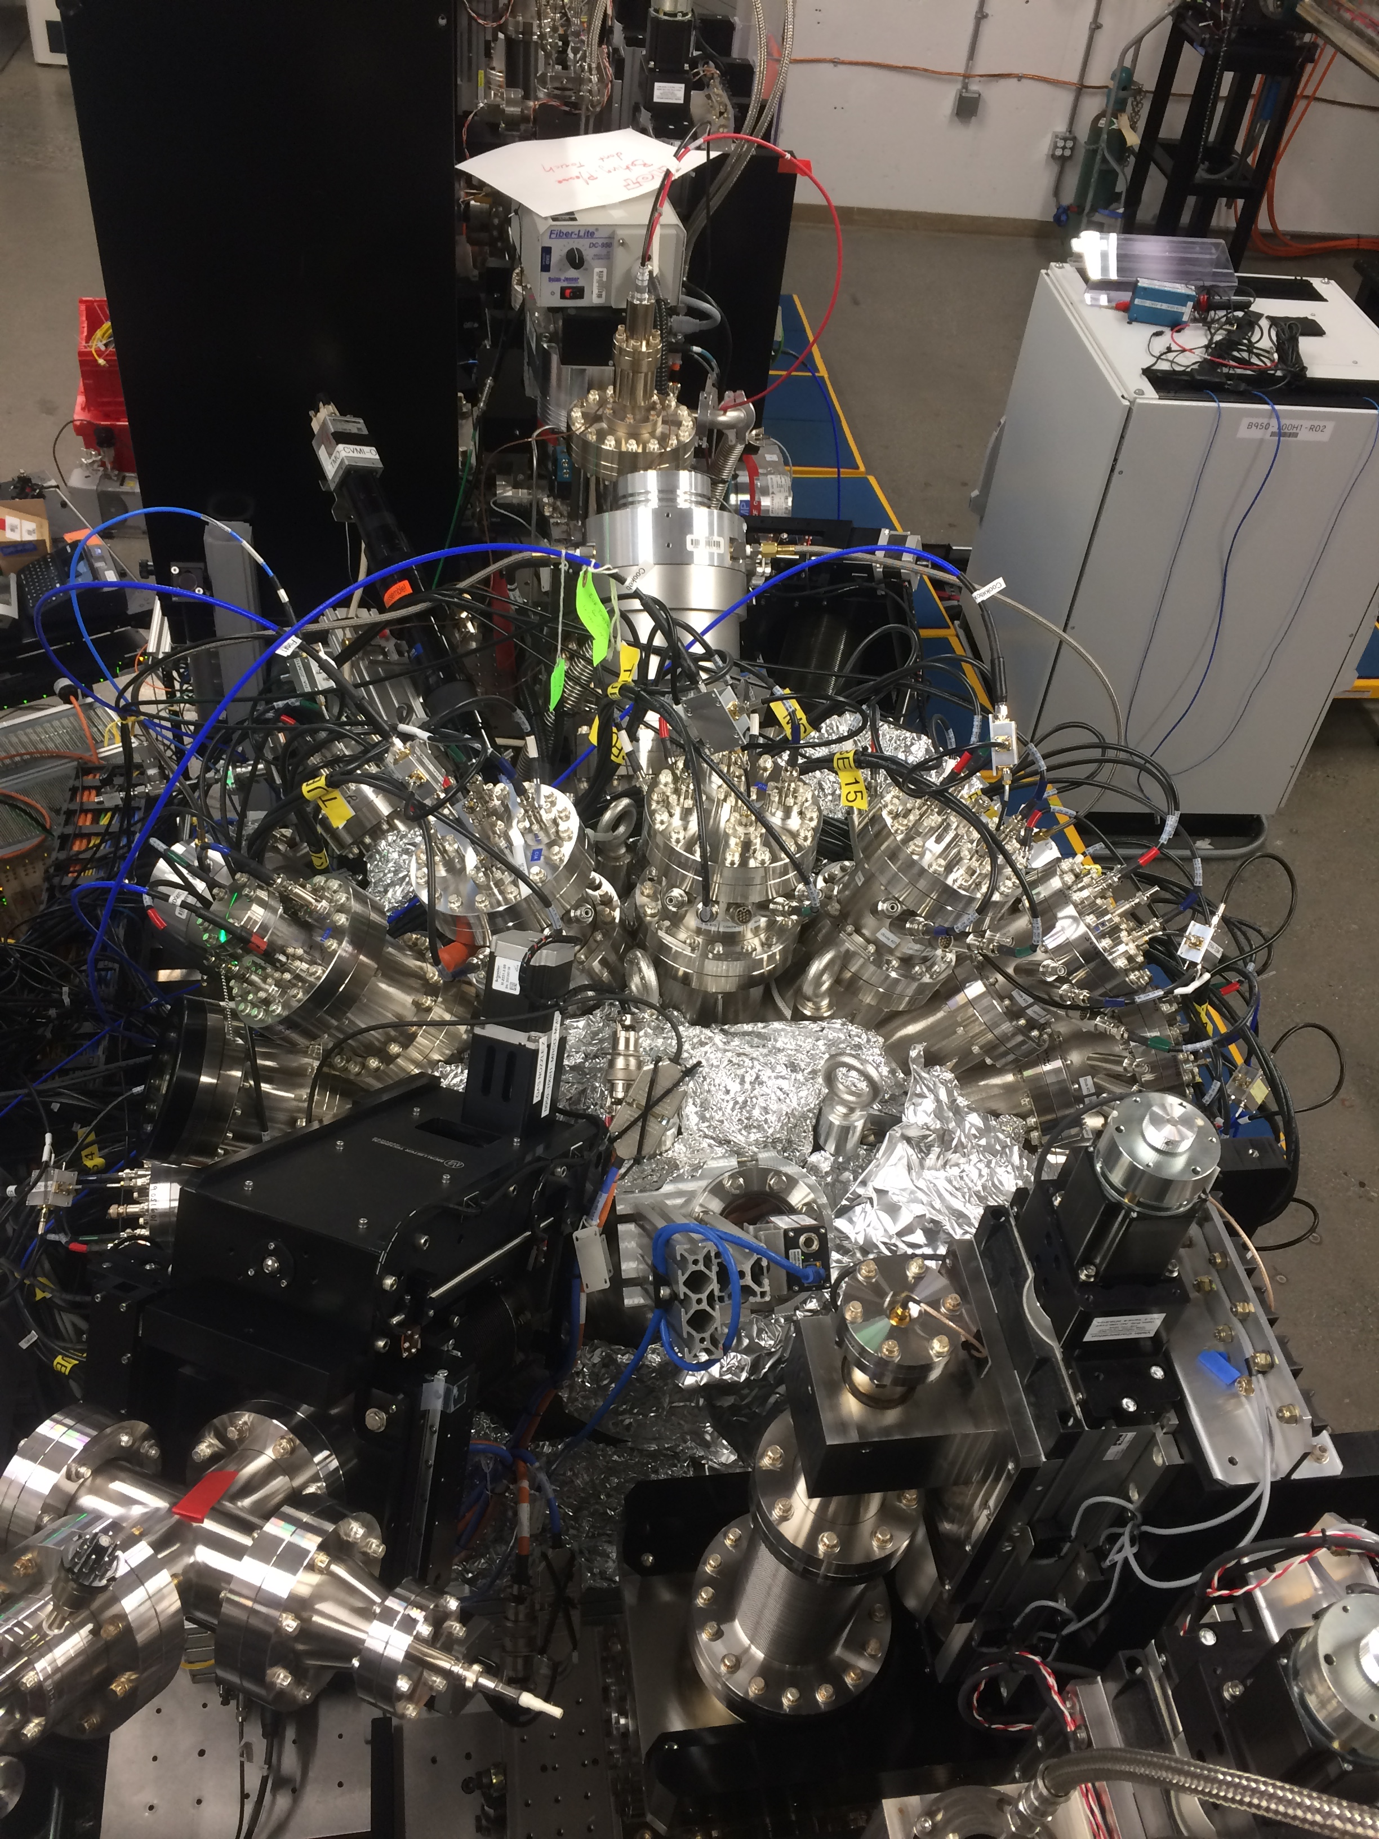
Installed system
Side view
Top view
Cite submitted paper
<number>
Notes:
12

Slide 2
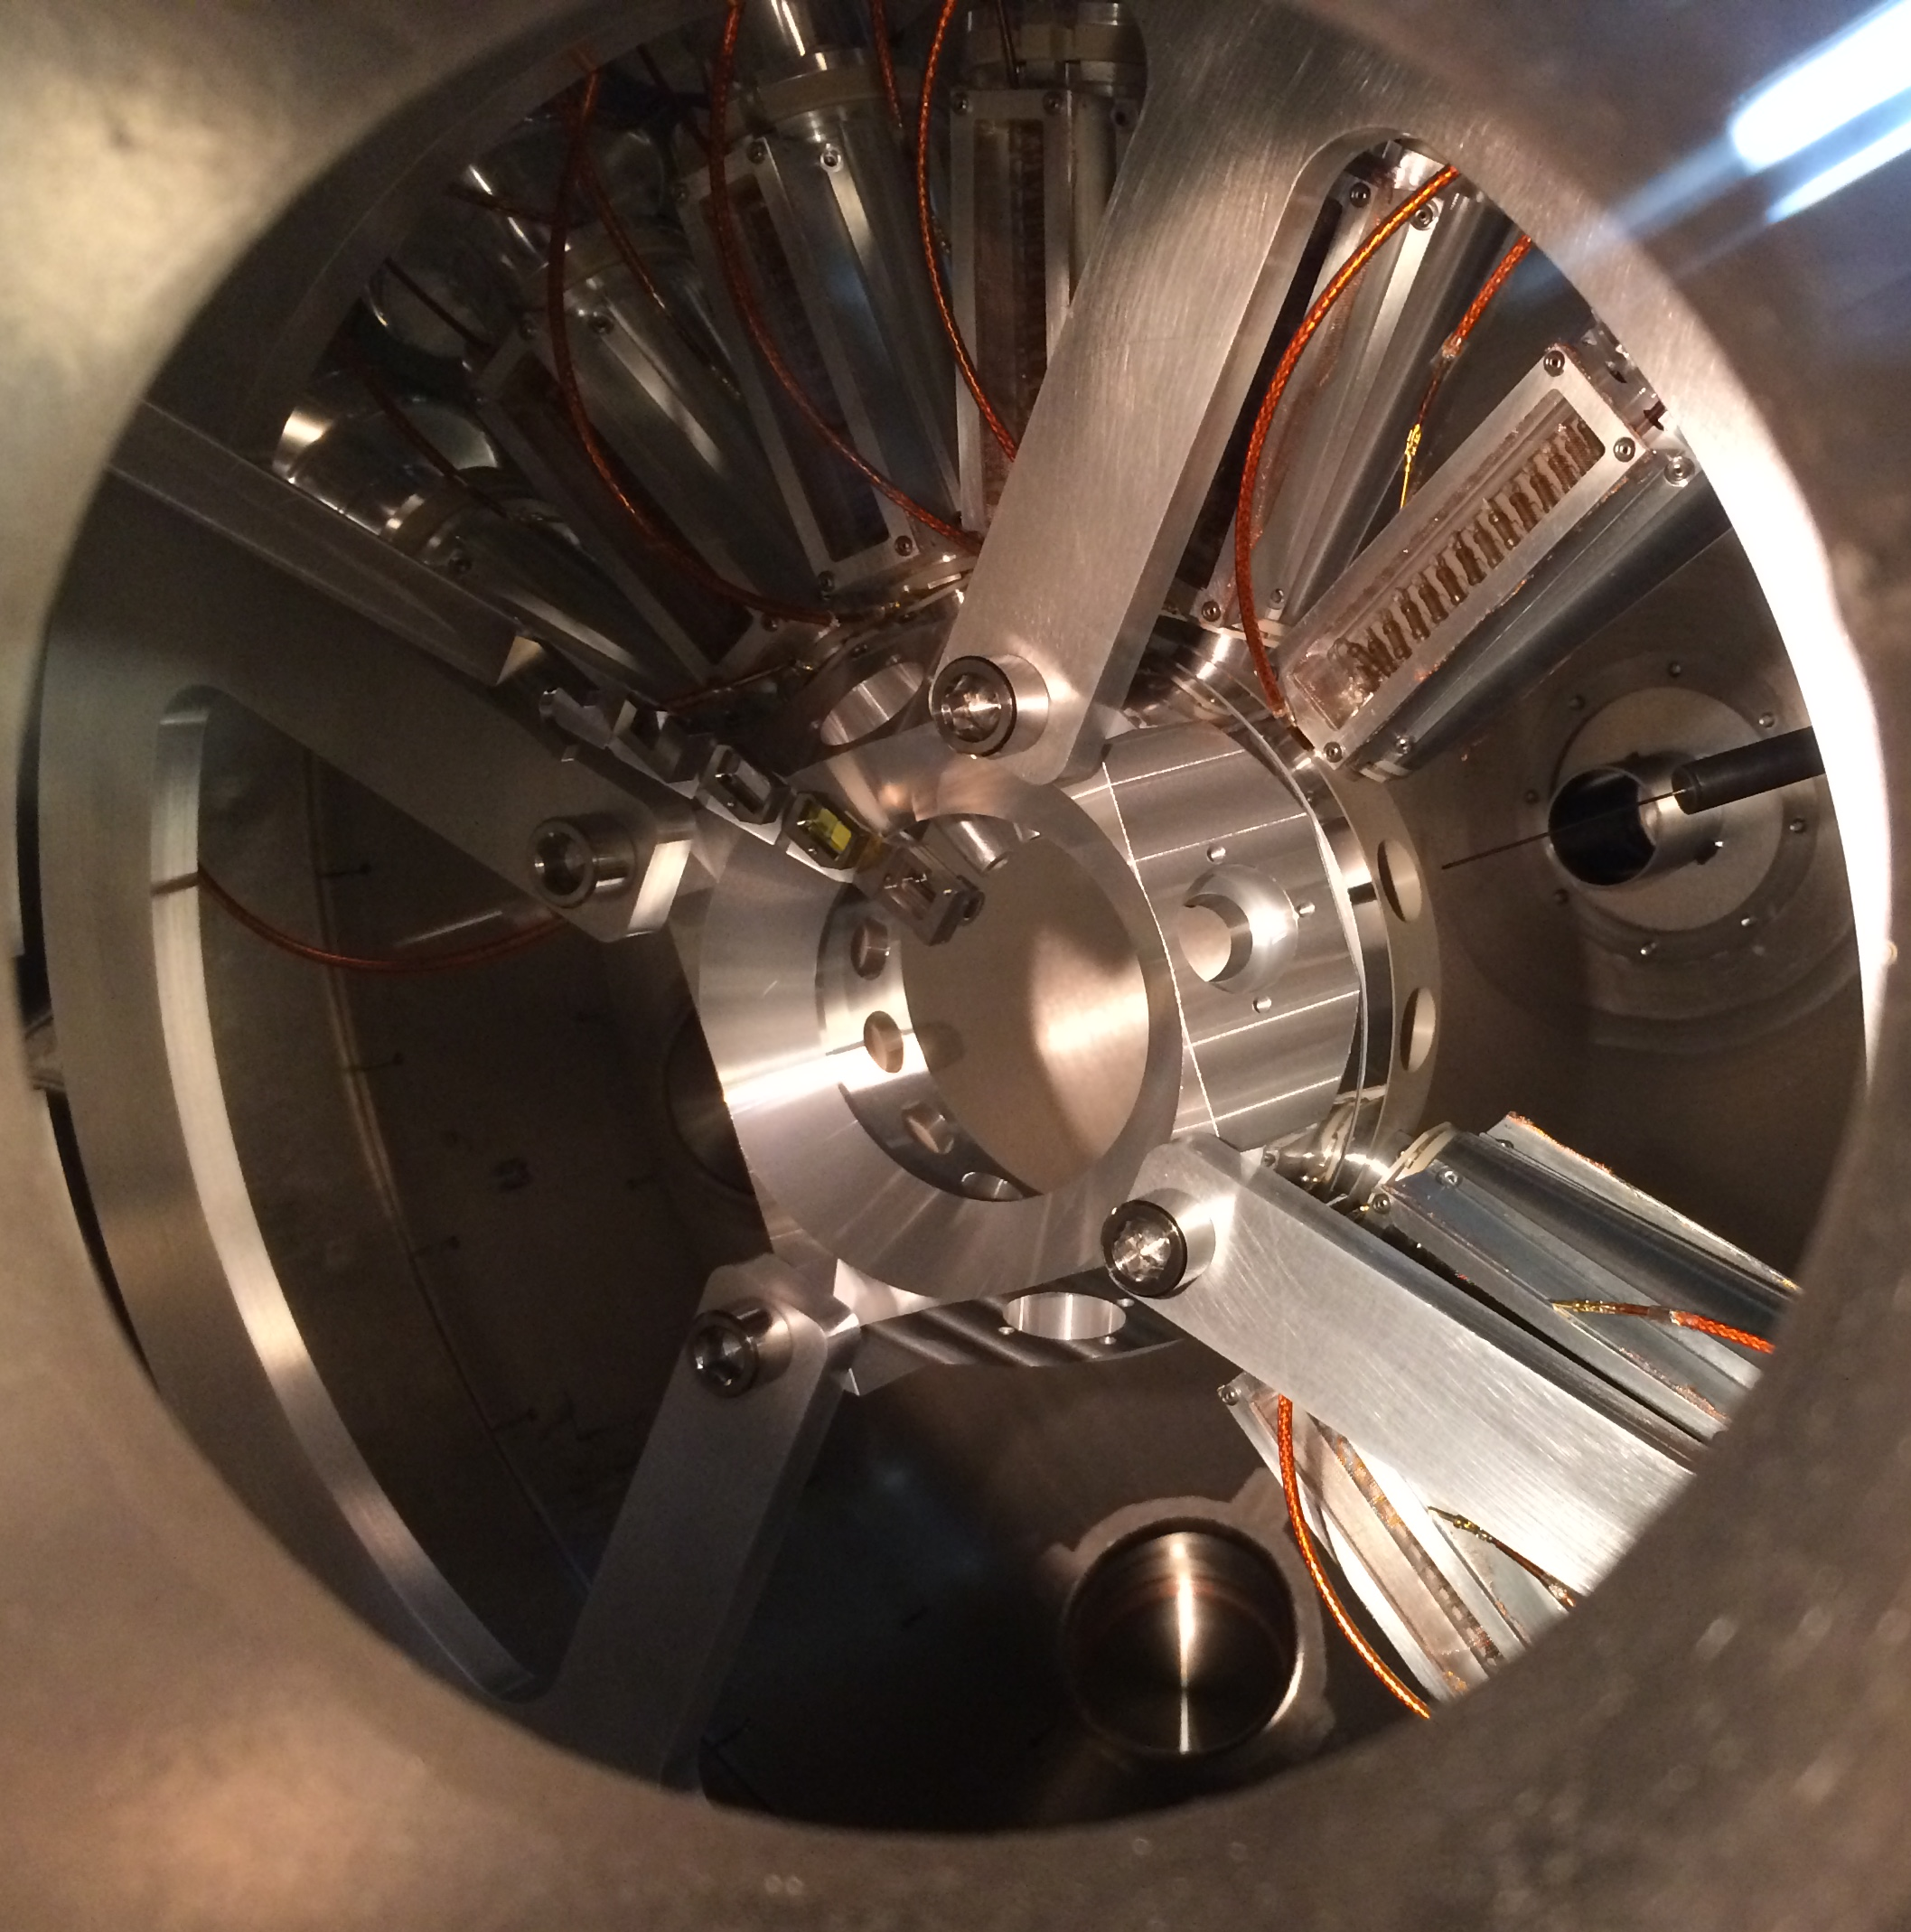
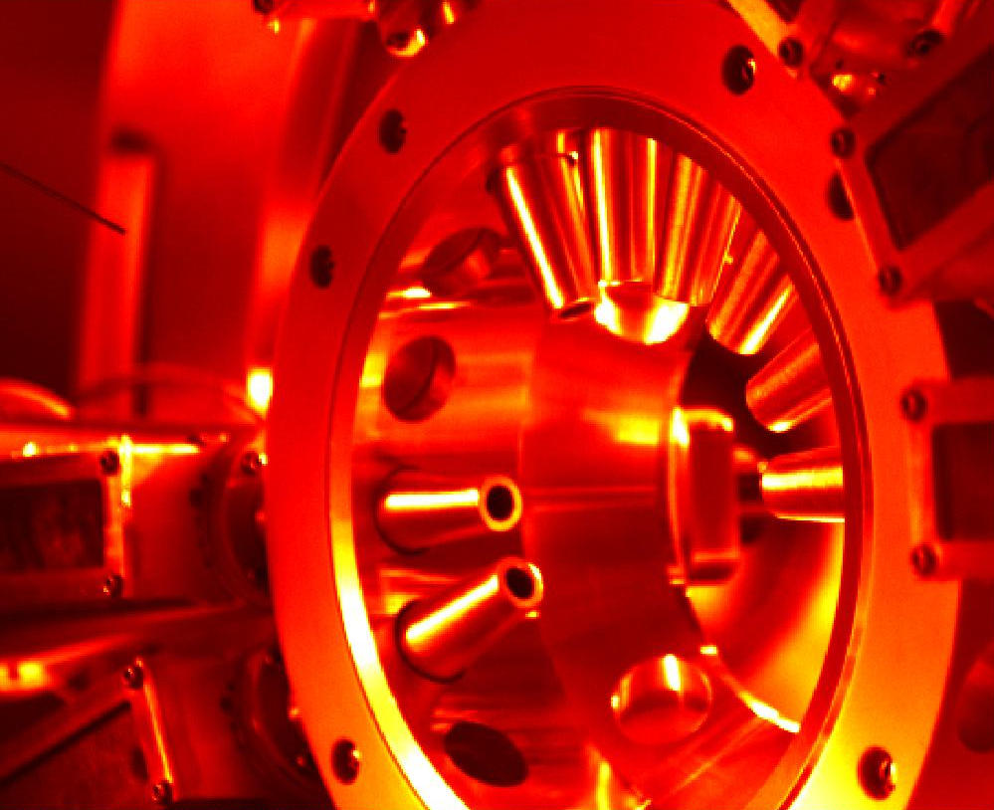
Inside the chamber
8 ToFs installed, 2 bare MCPs for “Current mode” resilience testing
Positioning paddle, Gas needle, 4 pumps
Front view
Back view
1
Notes:
12

Slide 3
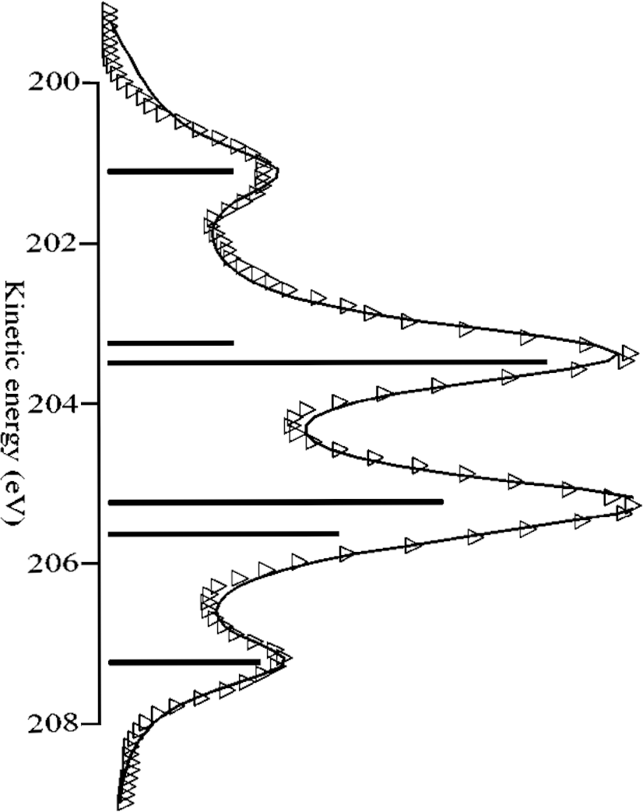
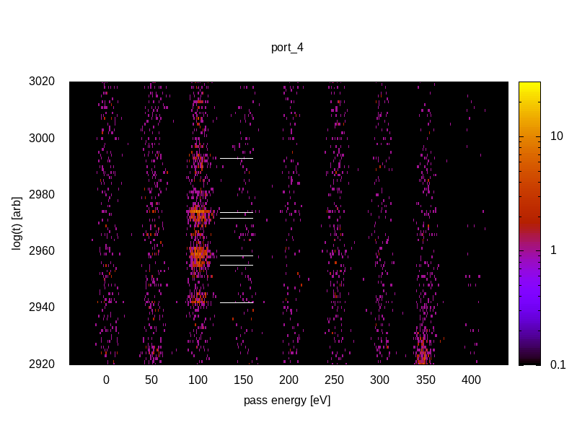
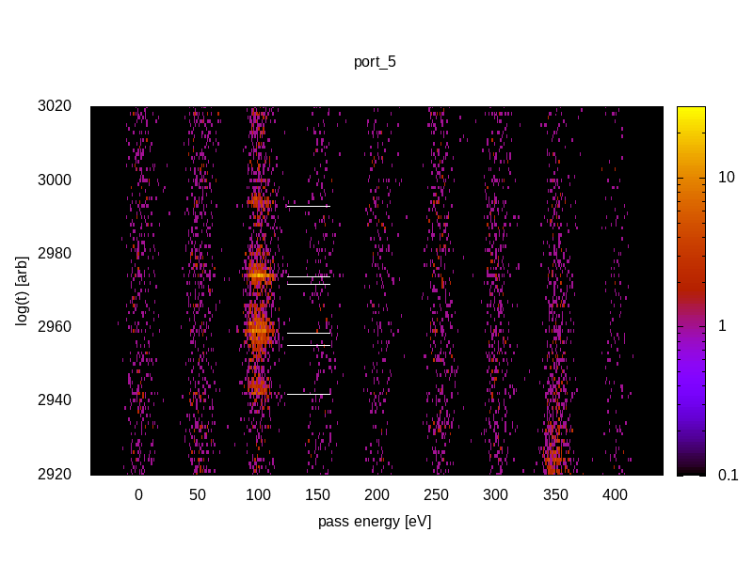
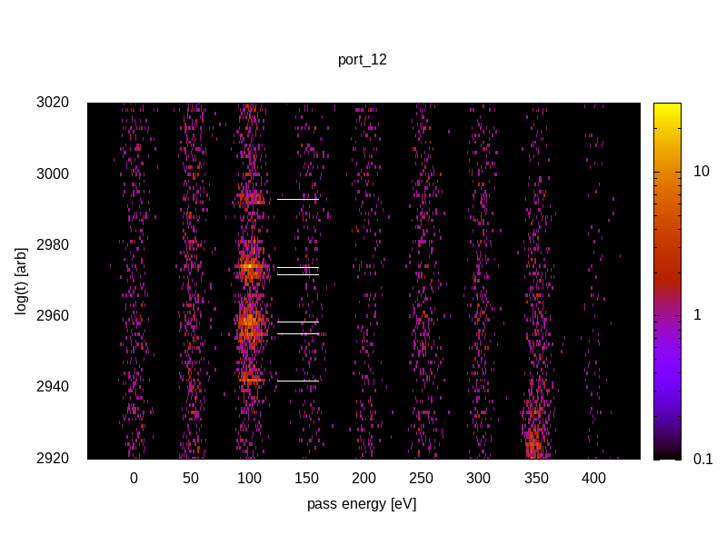
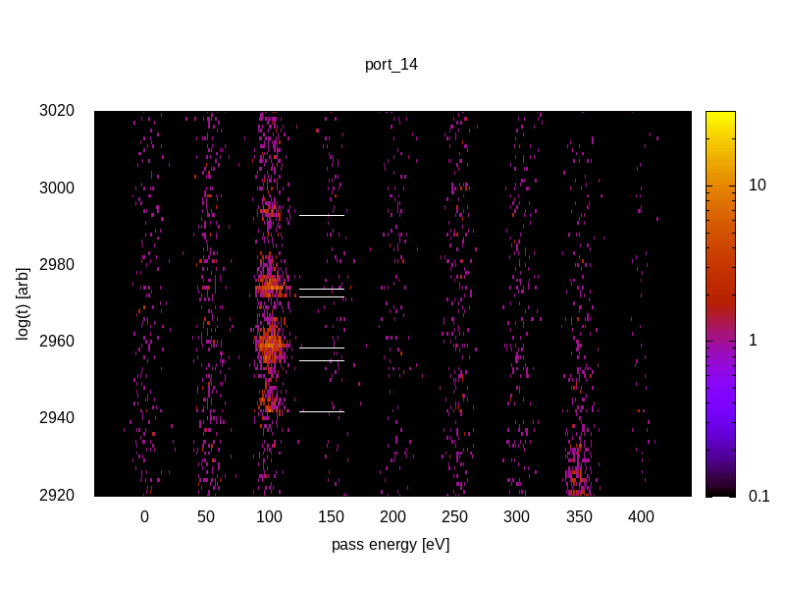



Resolution measurements with Argon LMM
201, 203, 205, 207 eV spectral features with 100 V retardation
Preliminarily ½ eV resolution at 100eV pass energy (maybe ¼ eV)
0
-90
90
Guillemin et al., Rev. Sci. Inst. 71, 4387 (2000)
90 112.5 -90 -45 -22.5 0 22.5
2
Notes:
12

Slide 4
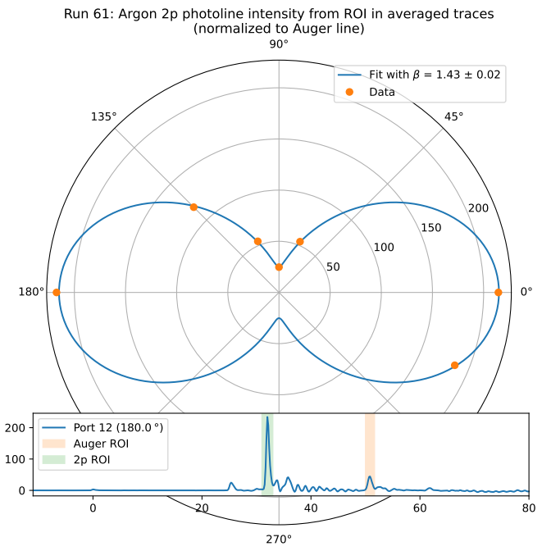
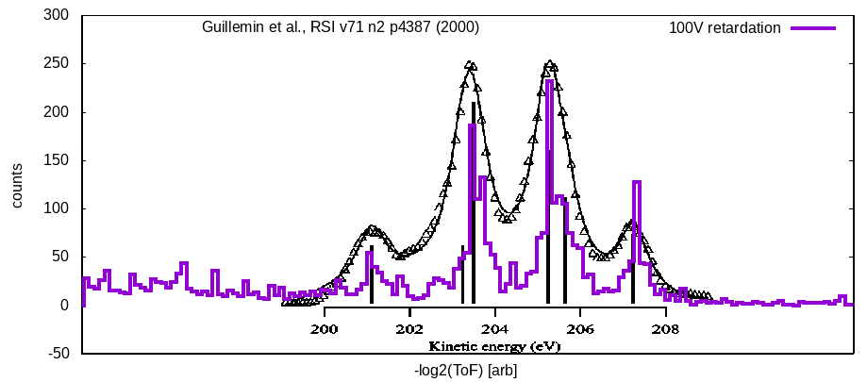
Argon LMM Auger resolution and 2p angular resolution
Courtesy Lars Funke
Looks like simulation
Measured 1.43 vs 1.465… validates use as polarimeter
Potentially ½ or ¼ eV resolution at 100eV pass energy
3
Notes:
12

Slide 5
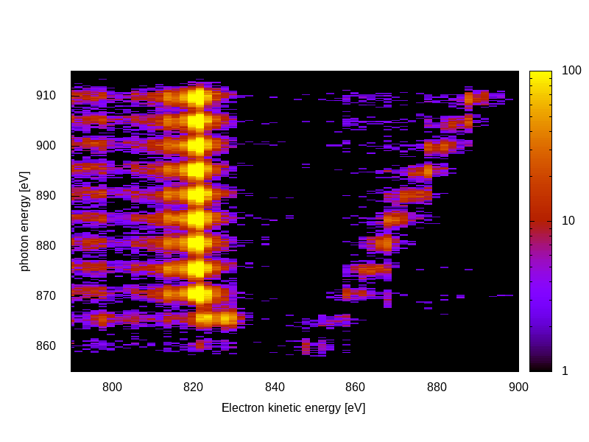
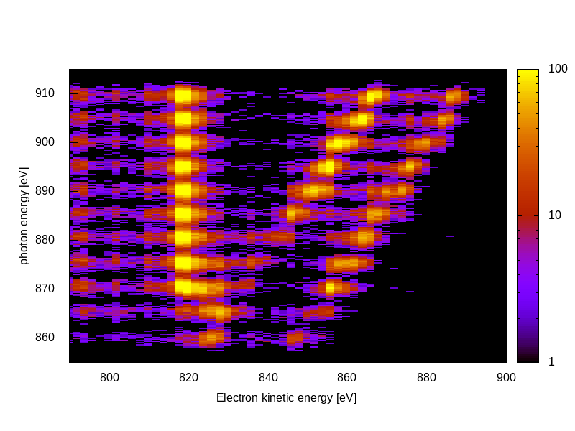
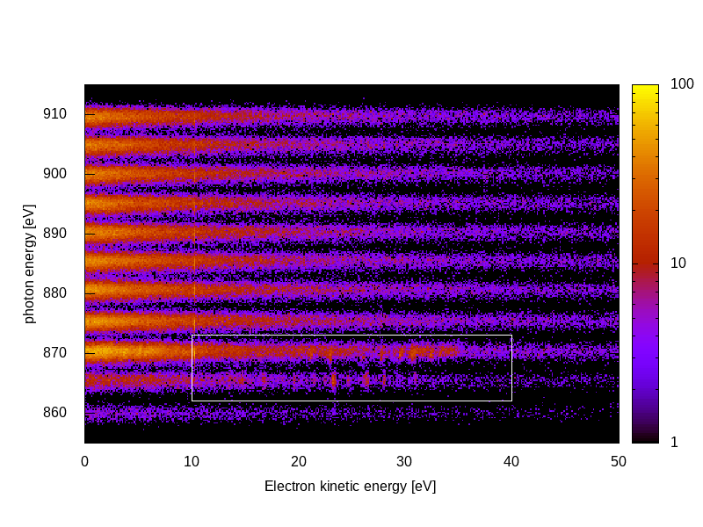
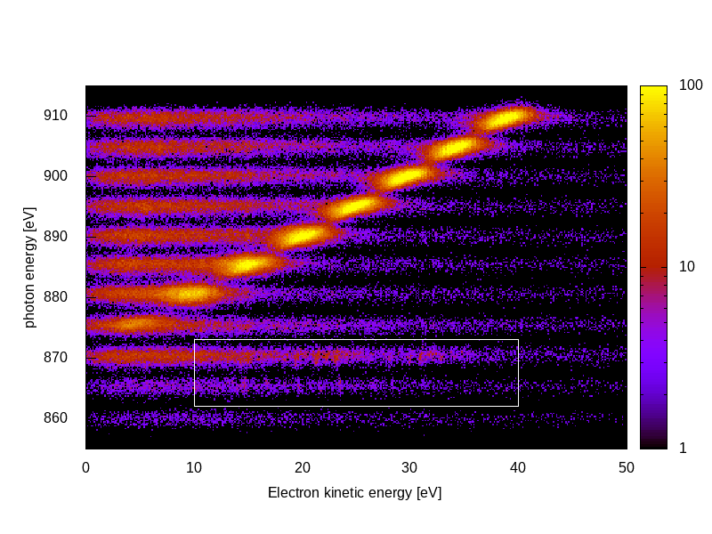
Neon Augers, Photos and Autoionizing 1s² 2s¹ 2p⁴ 3p E/dE > 200 for single 0 eV -- 1 keV spectral window
KLL
2s
2p
KLL
2s
2p
Low energy electrons highly sensitive to magnetic fields
Previous CookieBox experienced significant dependence of angular patterns to Helmholtz coil nulling fields
Steel chamber tests were blind below 30eV
Vertical Horizontal
Secondaries
All the way down
to few eV
Autoionization
4
Notes:
12

Slide 6
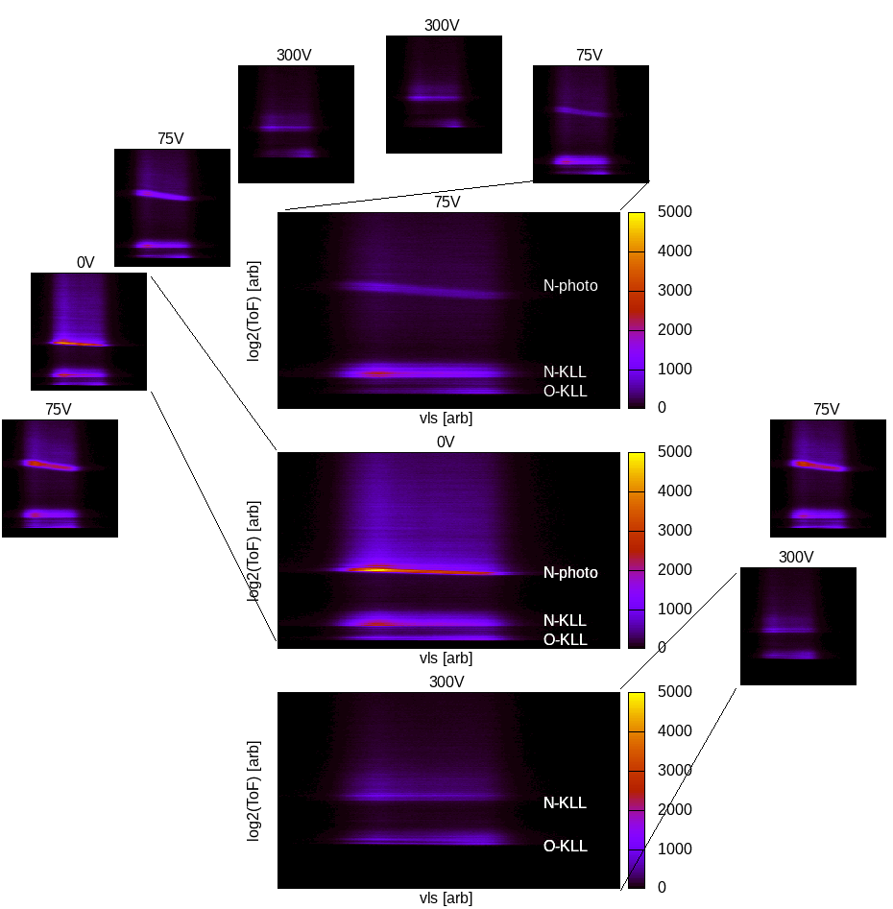
Multi-edge resolution
N₂O Resonant Auger
N 1s photoelectrons (75V)
N KLL and O KLL Auger electrons (300V)
Haven’t yet pushed resolution here yet
Surrogate demonstration for multi-color measurements
5
Notes:
12

Slide 7

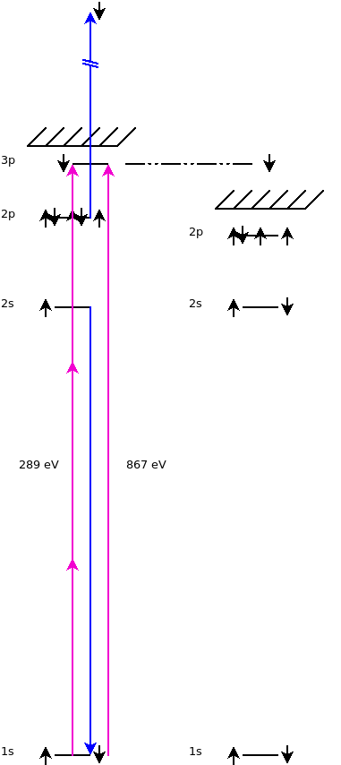
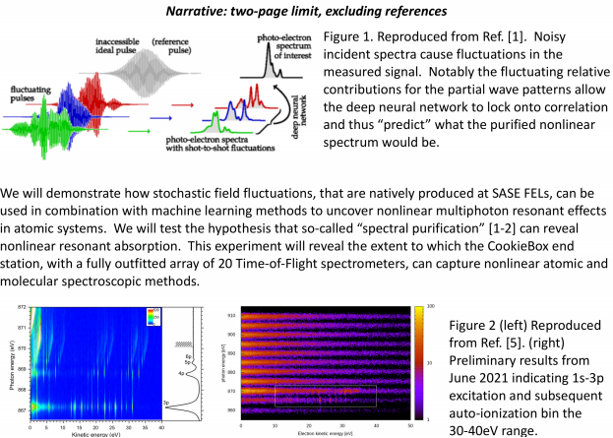
Autoionizing features motivates multi-path interference
Readout
channels
Ulf Saalman and Jan Michael Rost for enhancement of non-linear signals because of SASE, Inhouse proposal submitted last Friday
“Spooktroscopy” and attoclock ptychography as super-resolution methods in the time-energy domain … Daniel Ratner engaged, Alberto Lutman mode used in beamtime
Dynamic Chirality by fs-scale time-dependent polarization shaping
6
Notes:
12

Slide 8
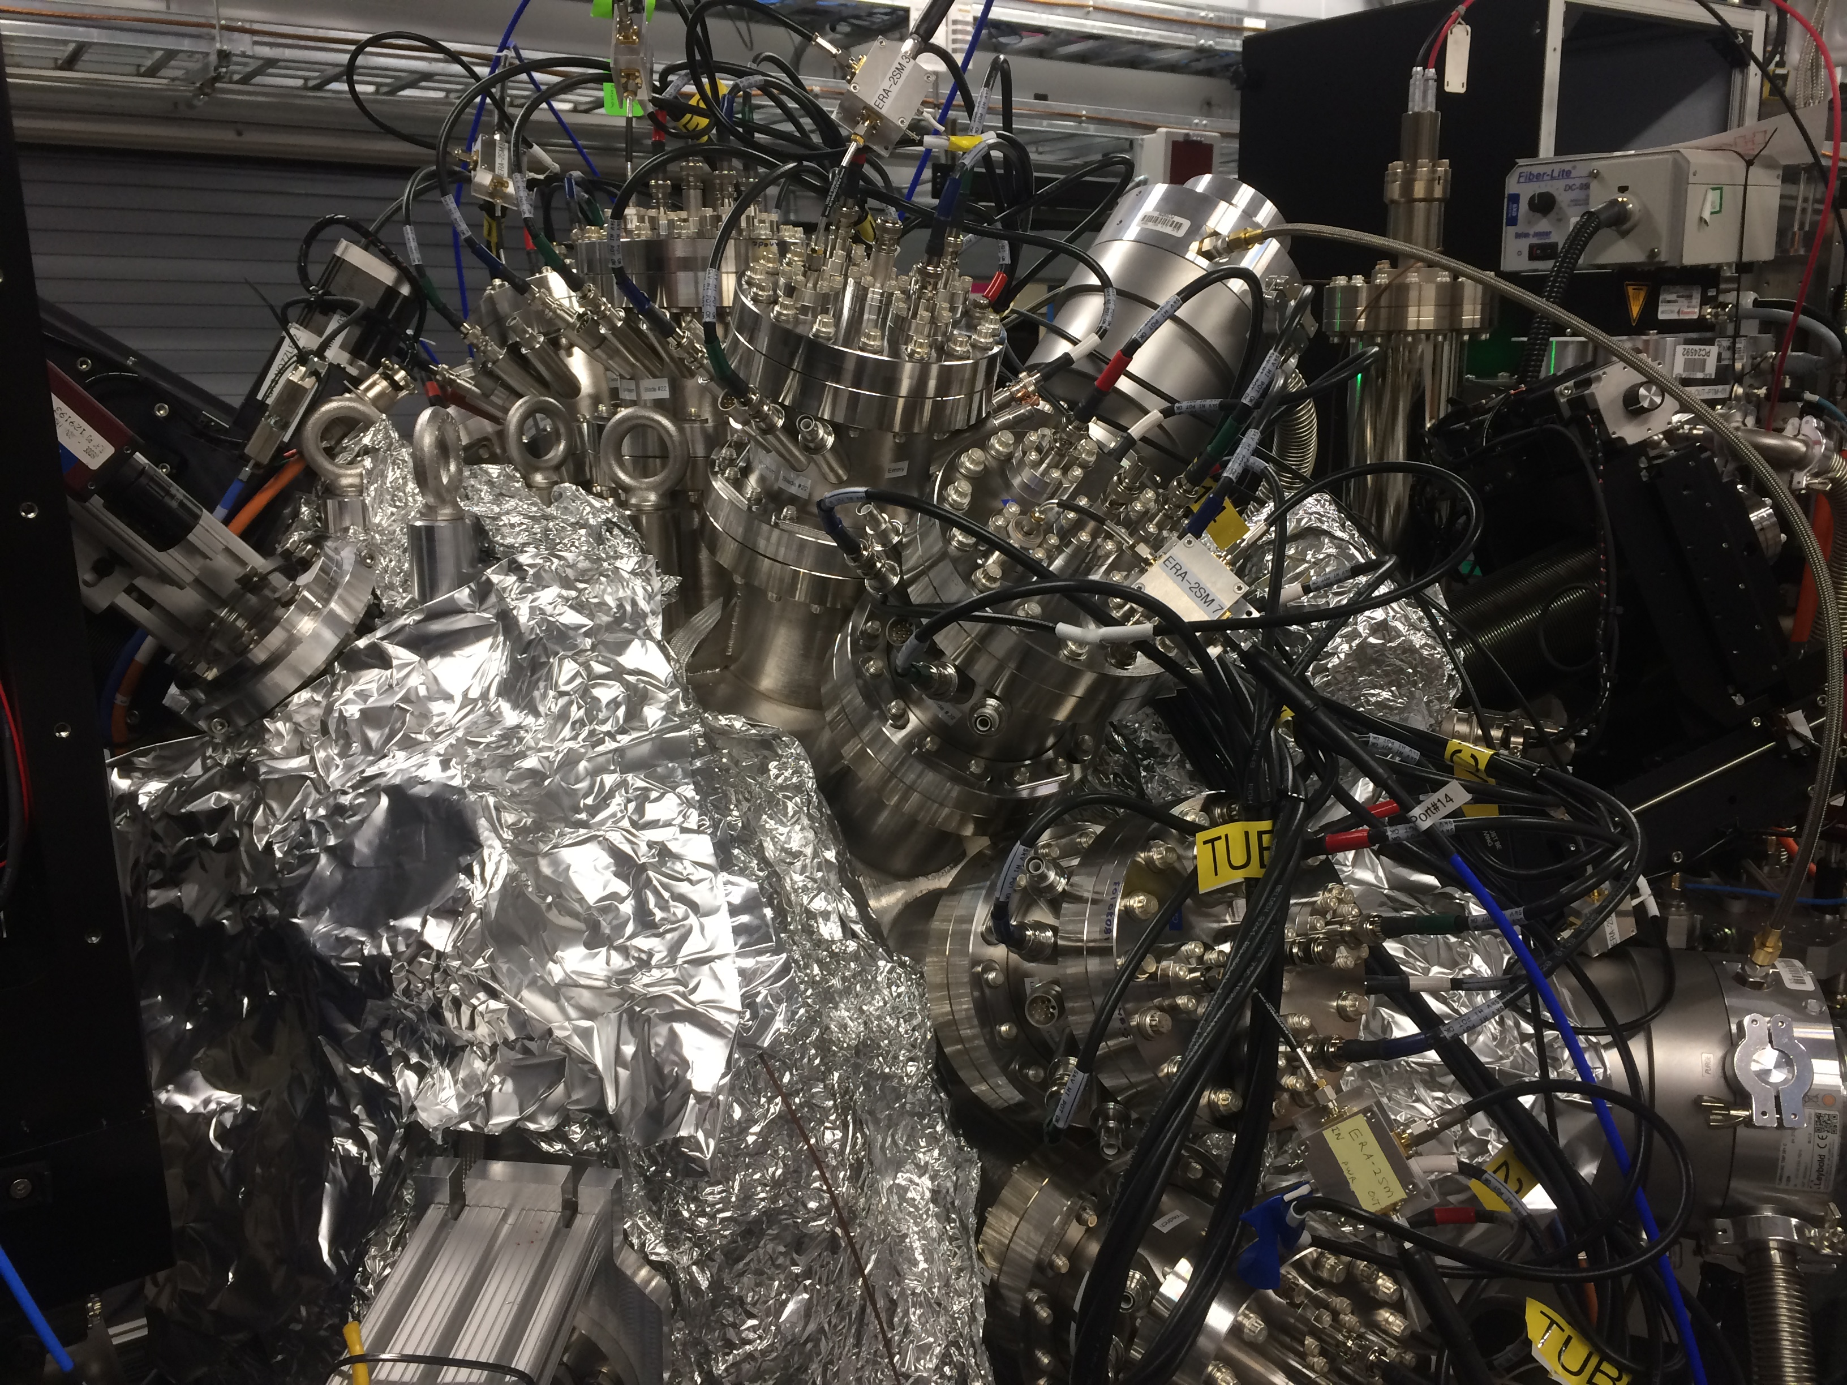
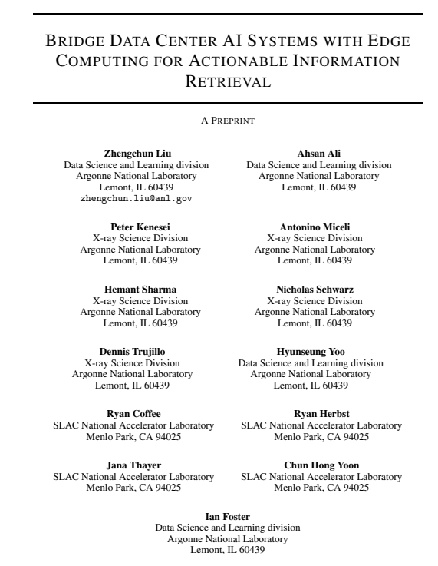
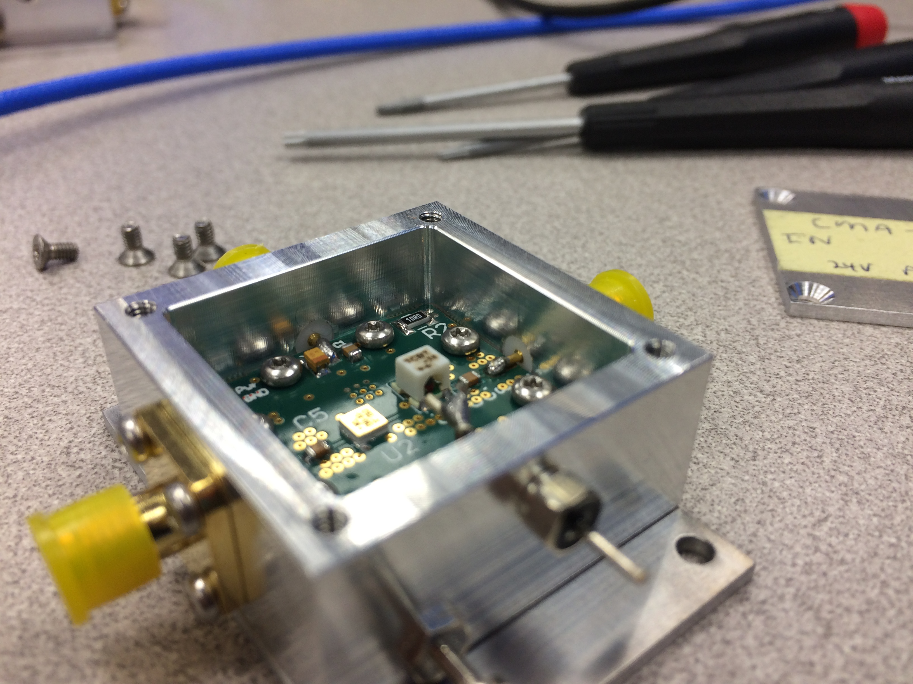
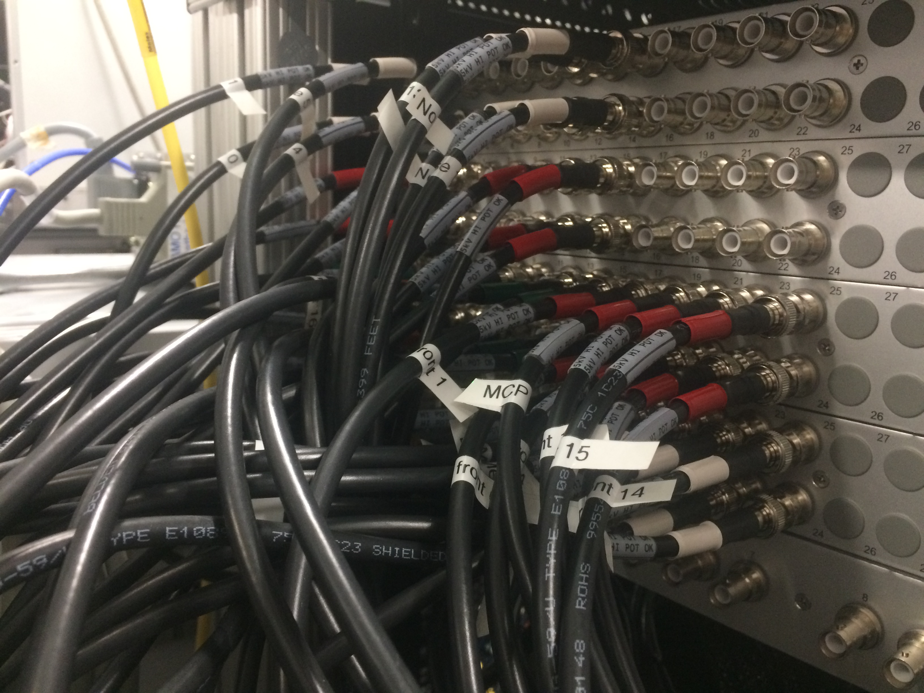
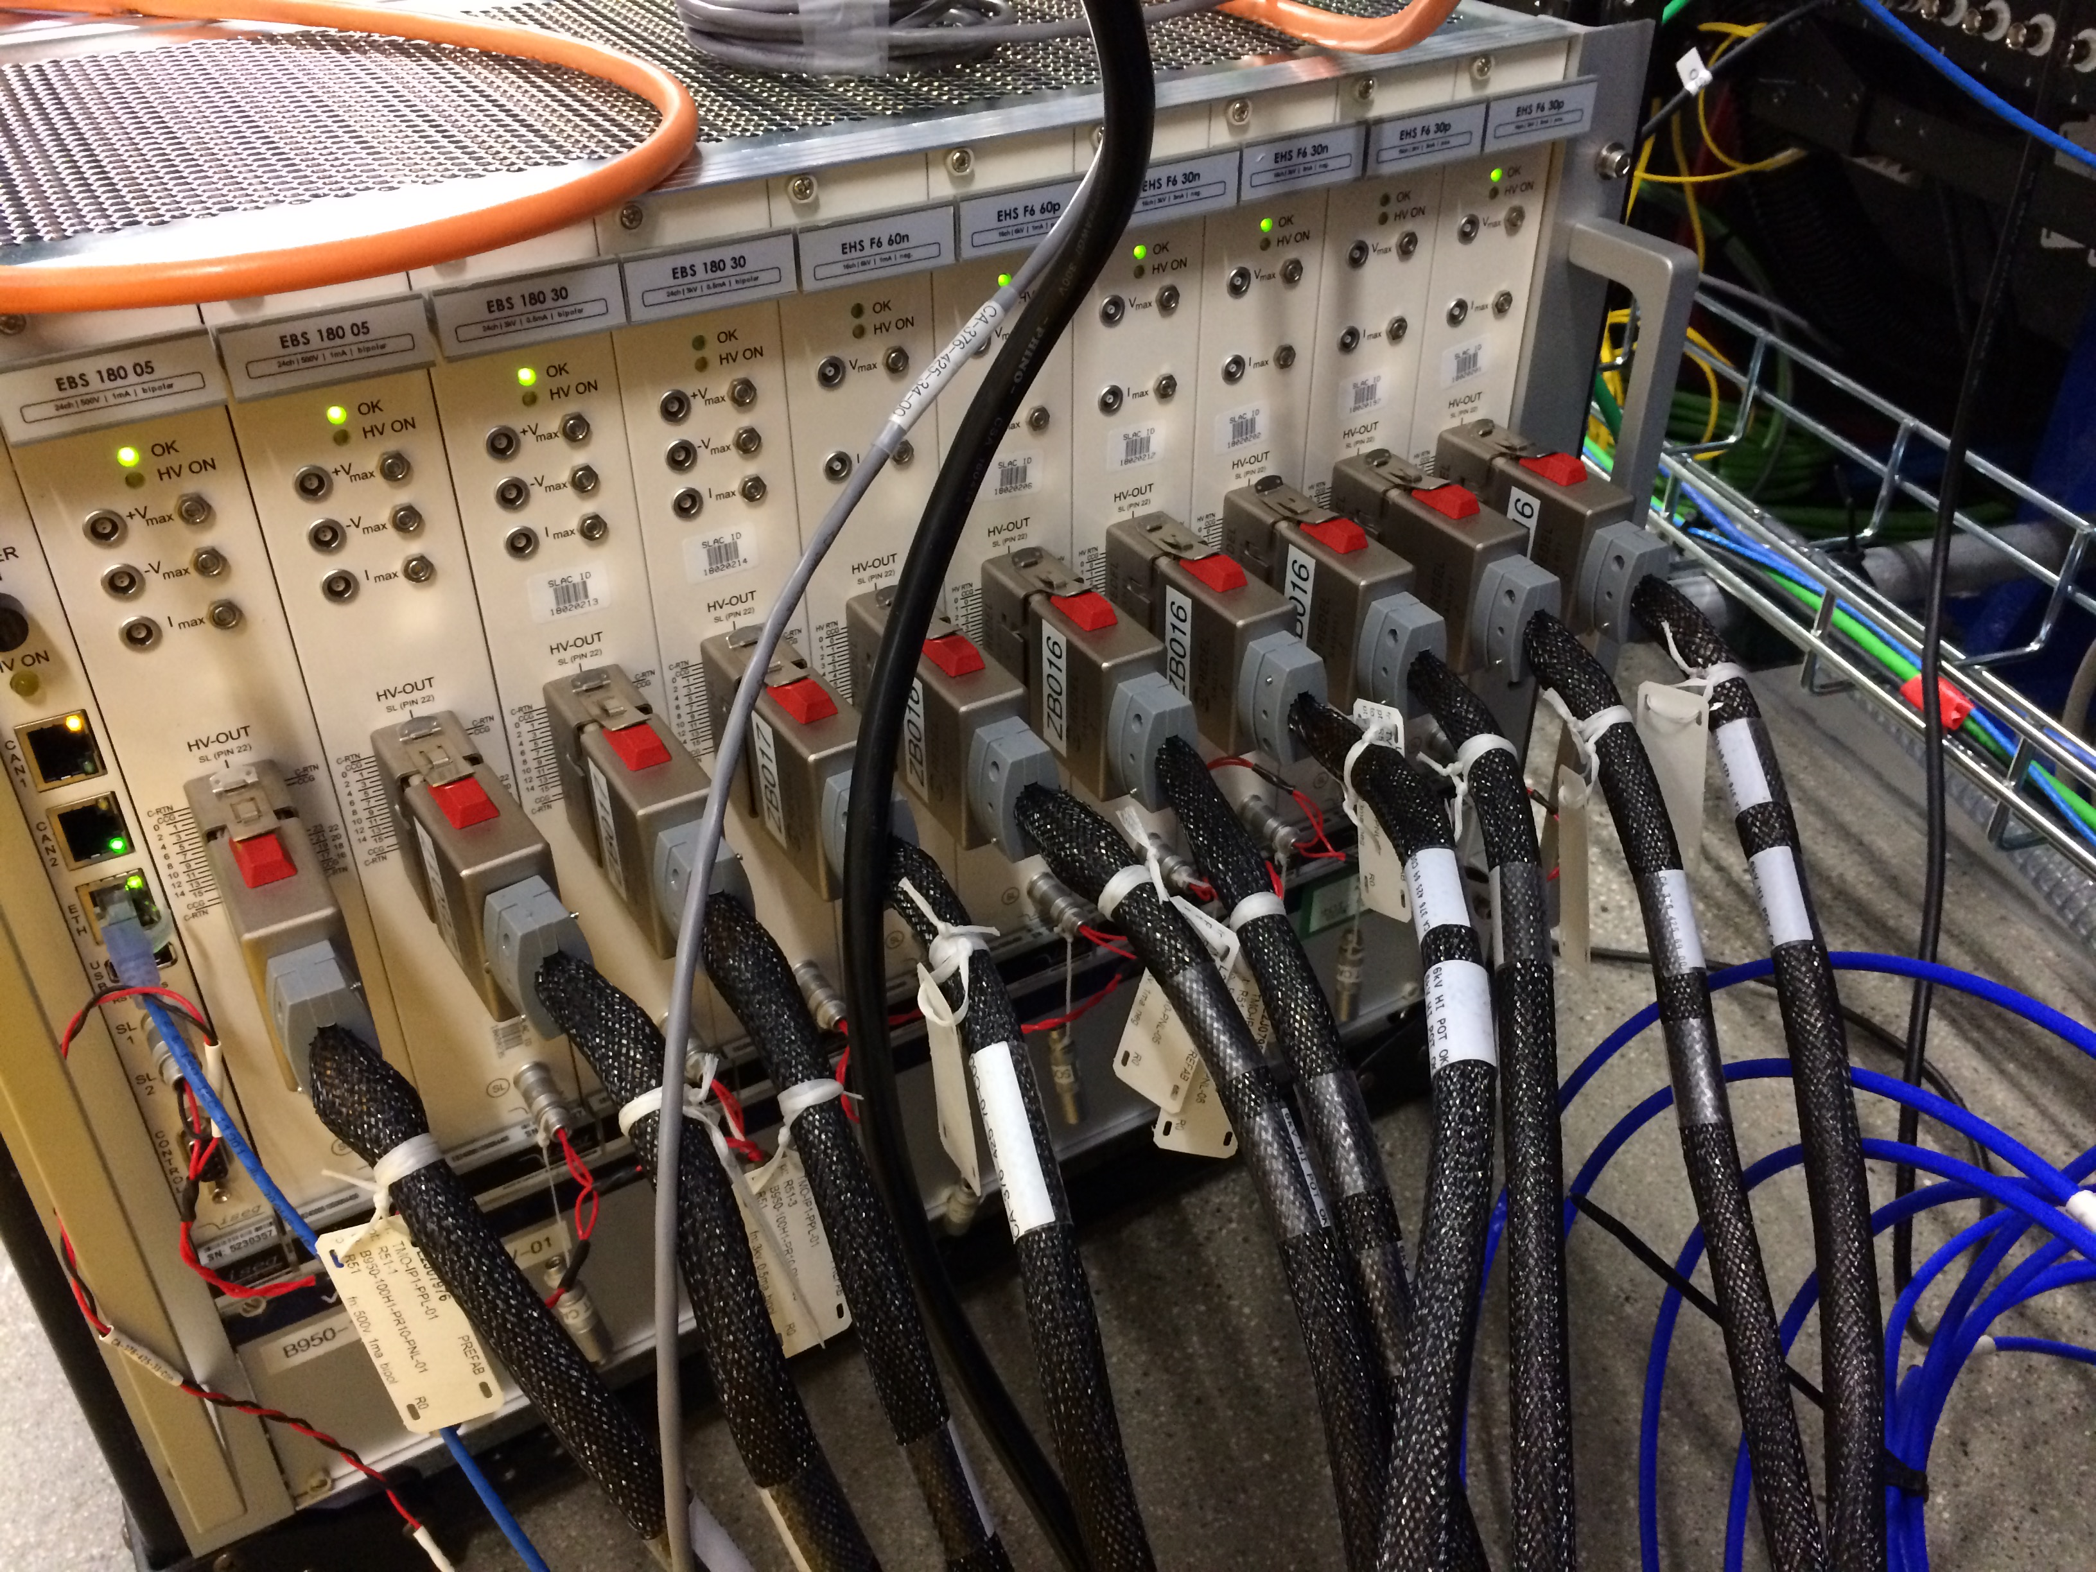
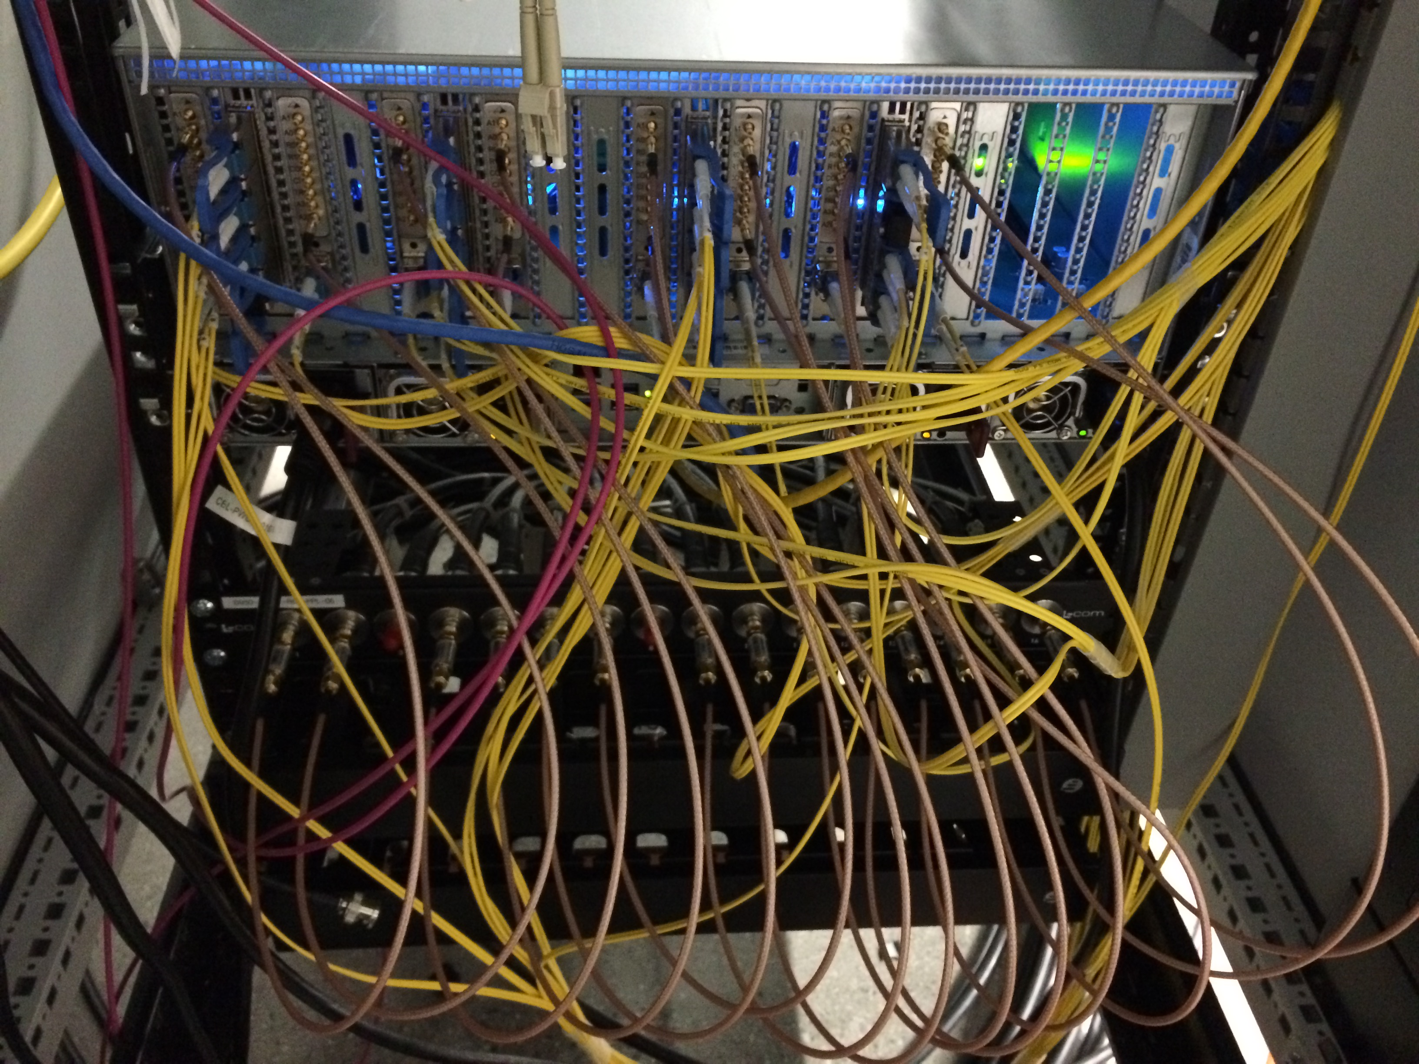
High Density HV, High Density Data
From 70 SHV cables in June from patch panel...
… to a full build out of 160 SHV channels
Ideally MDC can do High Density vacuum feedthroughs in mu-metal spools
Very “sensor” frontier of EdgeML
Can we put an ADC, FPGA, and EdgeTPU actually on the flange?
7
Notes:
12

Slide 9
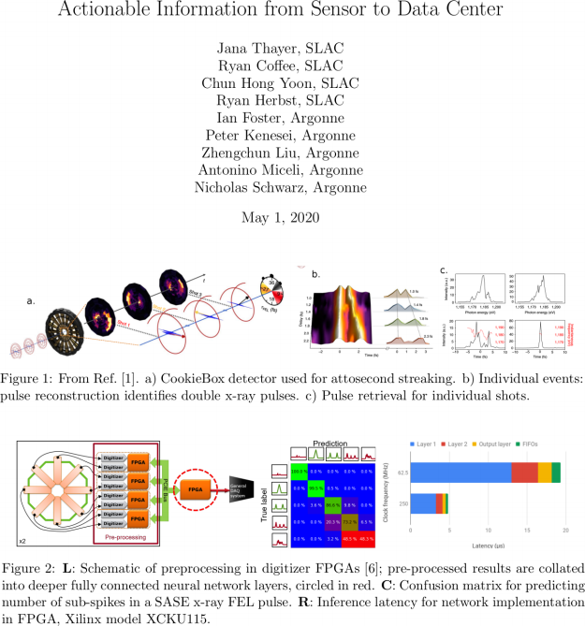

Enabling Strategic Developments – EdgeAI
AISDC
Tixel for ToFs
Corbeil Therrien et al., “Machine Learning at the Edge for Ultra High Rate Detectors” NSS-MIC, 1-4, (2019) doi: 10.1109/NSS/MIC42101.2019.9059671
<number>
Notes:
12

Slide 10
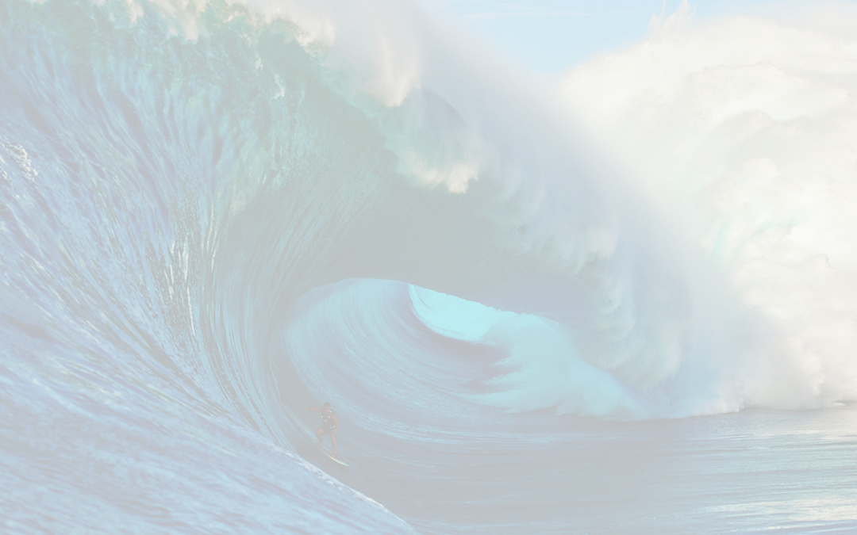
The CookieBox → MRCO Team
Omar Quijano (TID-AIR Staff)
EdgeML system admin
Matt Feldman (EE/CS PhD Student) – Samba Nova
Spatial-lang for FPGA
Audrey Corbeil-Therrein (Banting Post-Doc Fellow) – Faculty @ U. Sherbrooke
FPGA developer and ASIC design
Andrei Kamalov (TMO Post-Doc)
Laser lab testing and demonstration, CookieBox design and assembly, beamtime co-lead
Razib Obaid (TMO Project Scientist)
Detector R&D, CookieBox assembly, beamtime collaborator
Averell Gatton (TMO Post-Doc) – (Clostra, Inc.)
Simulations and model training, CookieBox design, beamtime author
Debadri Das (Applied Physics PhD Student)
Signal processing and algorithms
Jack Hirschman (Applied Physics PhD and CS Student)
RF electronics, FPGA, ASIC, and source control
Naoufal Layad (Institute for Computational and Mathematical Engineering Masters Student)
Surrogate modeling, Ensemble methods and Bayesian Networks
Coffee (CookieBox lead), Walter (TMO/MRCO lead), Dragone (ASICs/Detectors), Herbst (FPGAs), Cryan (AMO)
9
Notes:
12

Slide 11
Enabling Accelerator R&D and nonlinear x-ray methods
Attoclocking in the FEE
Bigest question was THz in the FEE
Zhirong Huang, Alan Fisher, and Matthias Hoffman have beam-based THz development project that could directly feed the CookieBox in the FEE with long wavelength light at rate!
LCLS-II developments CookieBox detector will support
Ago’s double XLEAP
Erik’s polarization shaping
Alberto’s Fresh Slice methods… actually how we ran June beamtime
Claudio’s Double Bunch and Harmonic Lasing
… anything FEL shaping related and multi-bunch, e.g. in-line beam-based THz
Scientific methods it will enable
X-ray multi-photon signals enhanced by SASE, In-house proposal submitted last Friday
“Spooktroscopy” and attoclock ptychography as super-resolution methods in the time-energy domain … Daniel Ratner engaged, Alberto Lutman mode used in beamtime
Dynamic Chirality by fs-scale time-dependent polarization shaping, needs DELTA undulator
10
Notes:
12

Slide 12
FY22 Technical R&D Topics
Immediate CookieBox design adaptations
Alternative to Zn/Ni/Au coating of ToF parts (although Aluminum worked well so far)
High density HV feedtroughs to interface to solderless block
Incorporate TIXEL area detector versus bucket detector MCP
Direct signal processing for inference
John Fox regarding custom MCP assembly for better RF signal decoupling
Razib Obaid and Bernhard Adams regarding glass embedded amplifier circuit with larger area MCP
Jack Hirschman’s idea to put ADC and FPGAs on the air side of the detector flange, e.g. featureize at the MCP.
High density HV supply for auto-tuning of compound electrostatic lens: Self-aware CookieBox
11
Notes:
<number>

